Slide 1
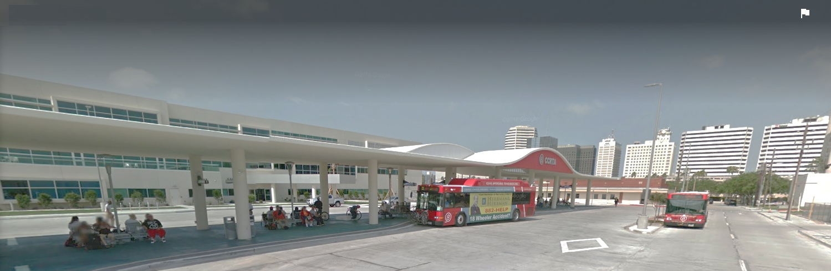

Proposed FY2019
Annual Operating & Capital Budget
Public Hearing
November 7, 2018

Slide 2
FY 2019 BUDGET CALENDAR
July & August
September & October
10/03 – Budget Workshop #2
November & December
11/07 – Submit Proposed FY 2019 Annual Operating & Capital Budget Host Public Hearing, Budget Adoption
12/05 – Date Open – Final Budget Adoption Deadline if Needed
07/25 – Budget Workshop #1
11/28 – Budget Workshop #4 If Needed
10/21 – POST PUBLIC NOTICES FOR BUDGET HEARING
(Submit GFOA Budget Document within 90 days after Budget Adoption)
10/24 – Budget Workshop #3
DRAFT

Slide 3
2019 BUDGET PRIORITIES
Public Image
Customer Service
Safety and Security
Procurement
Transparency
DRAFT

Slide 4


SERVICE FACTS
CCRTA service facts
Effective September 10, 2018
37 Services: 5 Express Routes,
29 Fixed Routes, 2 Demand
Response Taxi Services,
1 Demand Response Shuttle
B-Line Paratransit Service
Vanpool Services
841 Square Miles, 9 Communities
5.4 Million Passenger Trips*
1,338 Bus Stops
4 Transfer Stations
3 Park and Rides
Peak Fixed Route Vehicles: 70
Total Fixed Route Vehicles: 93
Total B-Line Vehicles: 34
Today
8/15/2017
11/10/2017
*Source: National Transit Database 2017 Annual Report

Slide 5
SERVICE FACTS
CCRTA service facts
Effective September 10, 2018 (continued)
System-wide Annual Total Service Hours*: 372,104
293,073 Fixed Route Service Hours Effective September 10, 2018 (-2.2% decrease from 2017)
System-wide Annual Total Service Miles*: 5,961,485
System-wide Annual Total Passenger Miles Traveled*: 24,312,263
Annual Operating Expenses*: $30,996,167
Annual Passenger Fare Revenue*: $1,696,457
Annual Farebox Recovery*: 5.5%
Today
8/15/2017
11/10/2017
*Source: National Transit Database 2017 Annual Report

Slide 6
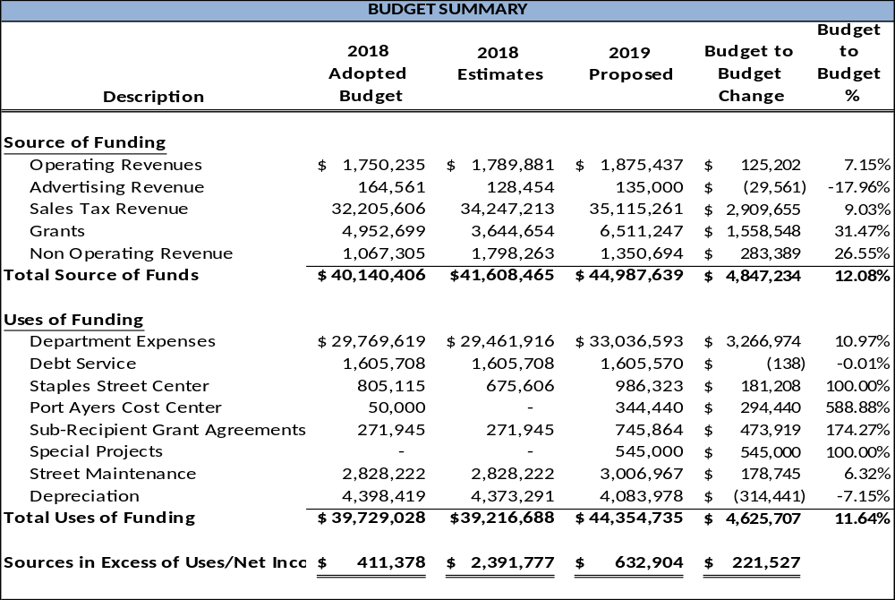
BUDGET SUMMARY
DRAFT

Slide 7
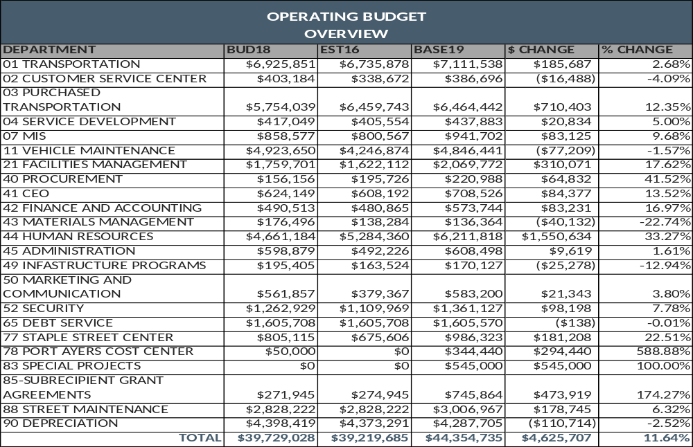
OPERATING BUDGET
DRAFT

Slide 8
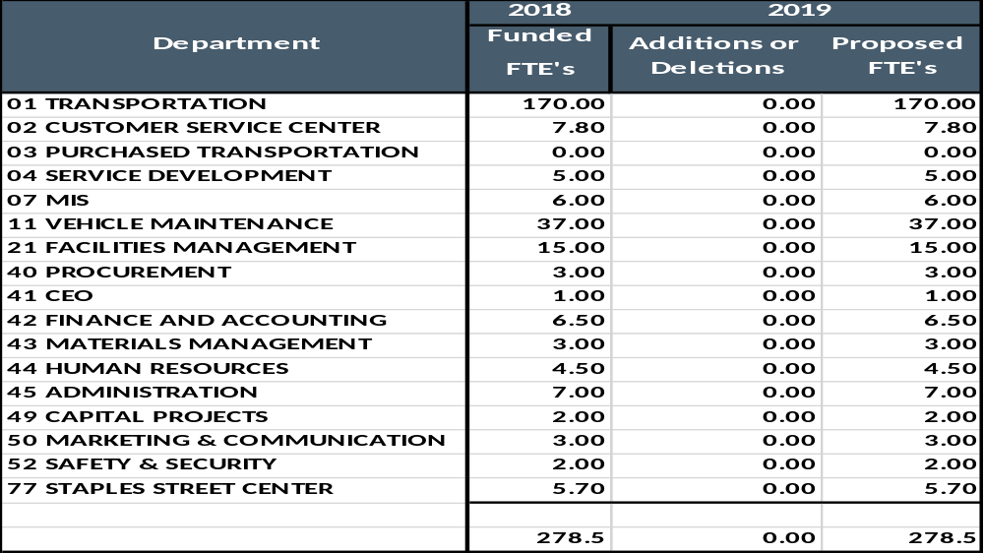
FULLTIME EQUIVALENT POSITIONS
DRAFT

Slide 9
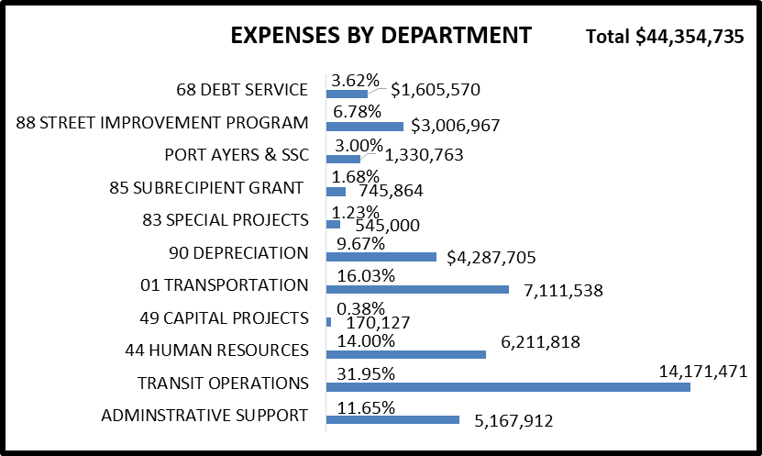
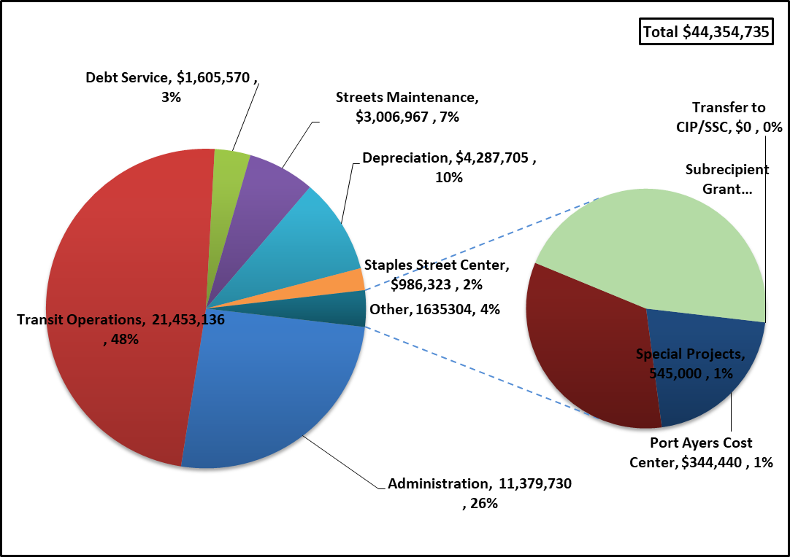
EXPENDITURES
DRAFT

Slide 10
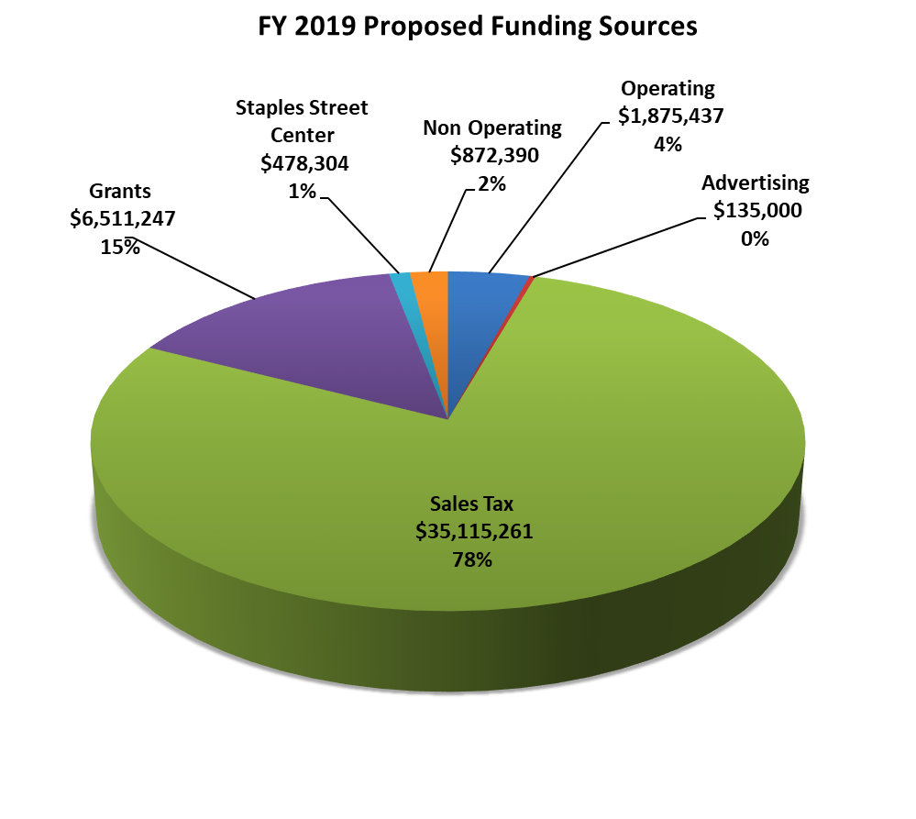
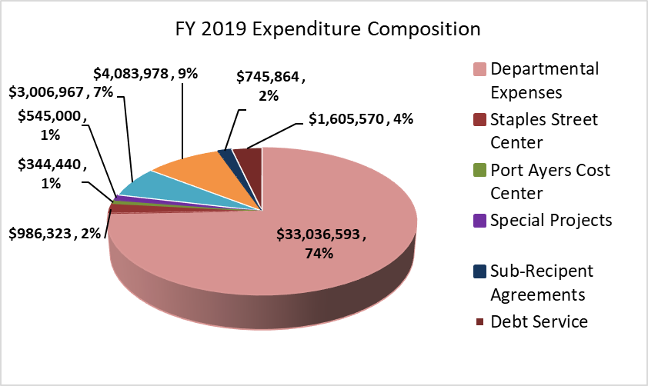
REVENUE / EXPENDITURES
DRAFT
$44,987,639
$44,354,735

Slide 11
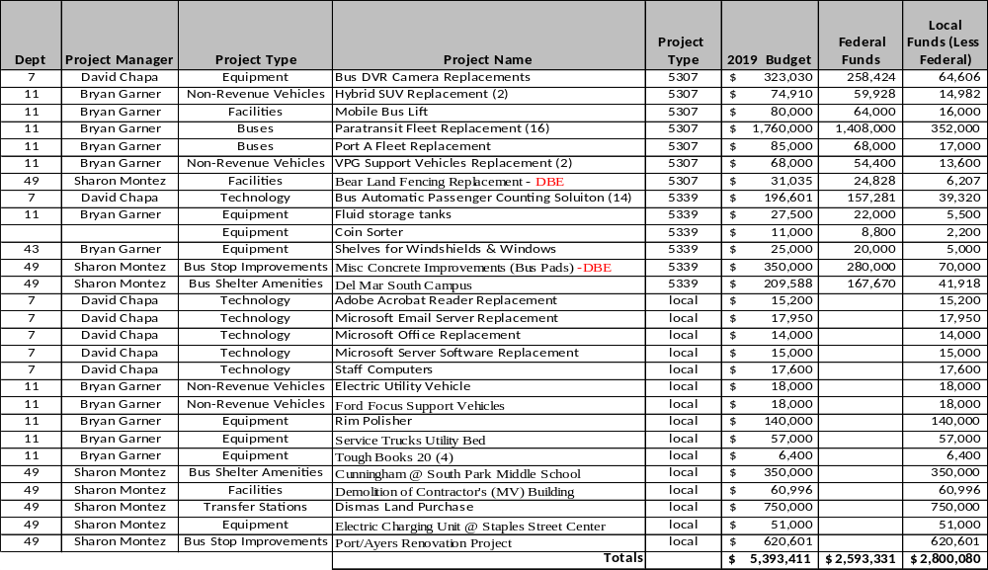
CAPITAL IMPROVEMENT PROJECTS
2019
DRAFT

