Slide 1
Proposed FY2020
Operating & Capital Budget
CCRTA Board Priority
Financial Transparency
Public Hearing #1
October 23, 2019

Slide 2

FY2020 Budget Calendar
12/04 Date Open – Final FY2020 Budget Adoption Deadline
(If Needed)
10/02 Budget Workshop #6
Submit GFOA Budget Document by 02/04/2020 (If adopted 11/06/2019 or within 90 days after Budget Adoption)
July-September
December
10/09 Post Public Notice for Budget Hearing #1
10/23 Host Public Hearing #1 (Evening)
Workshop #7 (If Needed)
Post Public Notice for Budget Hearing #2
07/10 Budget Workshop #1
08/07 Budget Workshop #2
09/04 Budget Workshop #3 & #4
09/25 Budget Workshop #5
October
November
11/27 Budget Workshop #8 (If Needed)
11/06 Host Public Hearing #2, FY 2020 Budget Adoption

Slide 3
Service
5 Express Routes (50,51,53,54,56)
29 Fixed Routes
2 Demand Response Taxi Services (DPS Shuttle, Paisano Transit)
1 Demand Response Shuttle (Flexi-B)
Flex Route 93
B-Line Paratransit Services
Vanpool Services

Slide 4
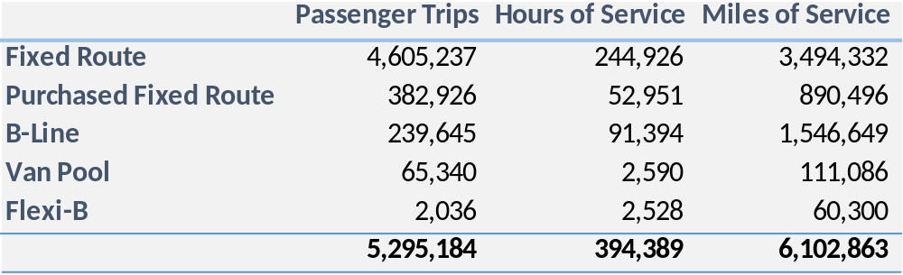
Service
846 Square Miles, 9 Communities
1,343 Bus Stops
4 Transfer Stations
3 Park and Rides
Fixed Route Vehicles: 76 Peak, 91 Total
B-Line Vehicles: 27 Peak, 34 Total

Slide 5
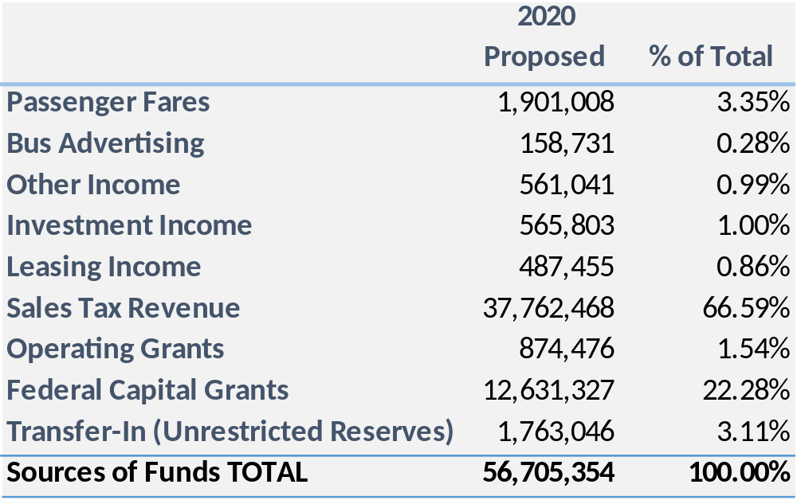
2020 Operating Budget
Sources of Funds

Slide 6
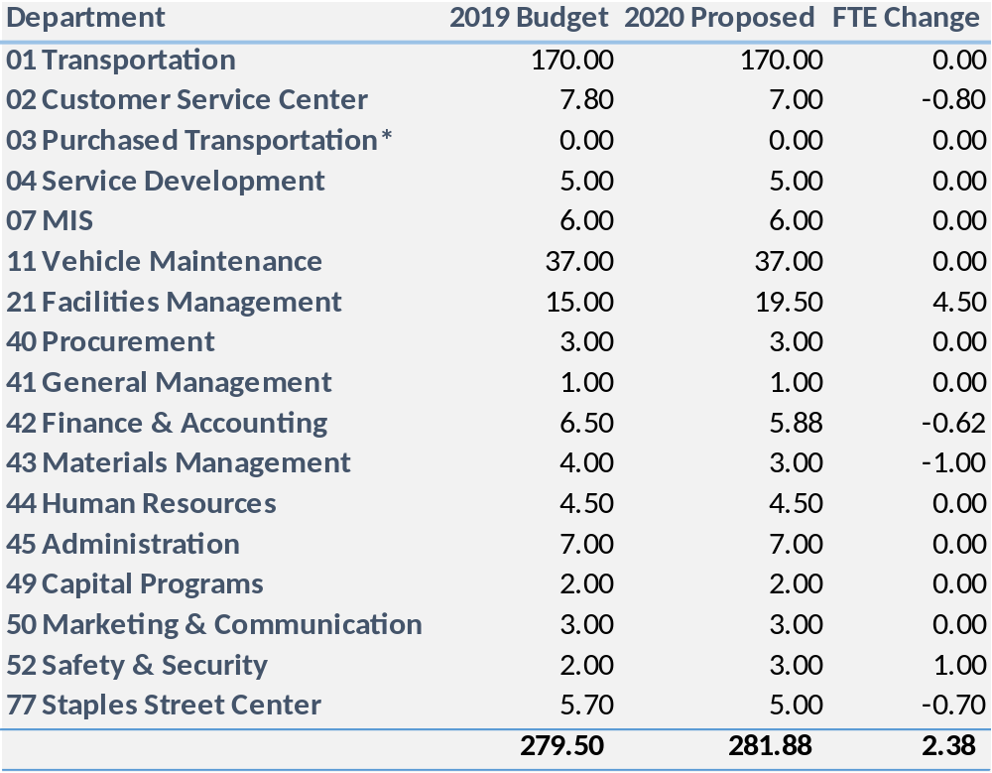
2020 Operating Budget
Fulltime Equivalent Positions
*Additional positions supported through Department 03 Purchased Transportation:
  MV 109
Notes:
Additional positions supported through 03 Purchased Transportation
MV
REAL
Paisano
Fulltime Equivalent Positions

Slide 7
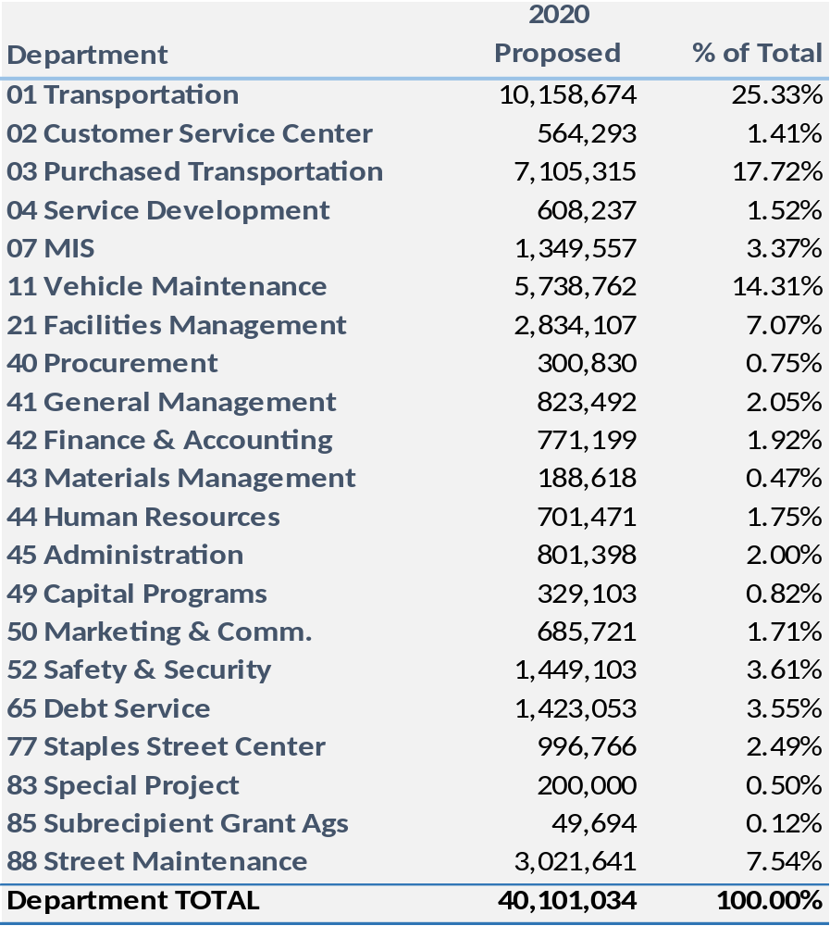
2020 Operating Budget
Uses of Funds

Slide 8
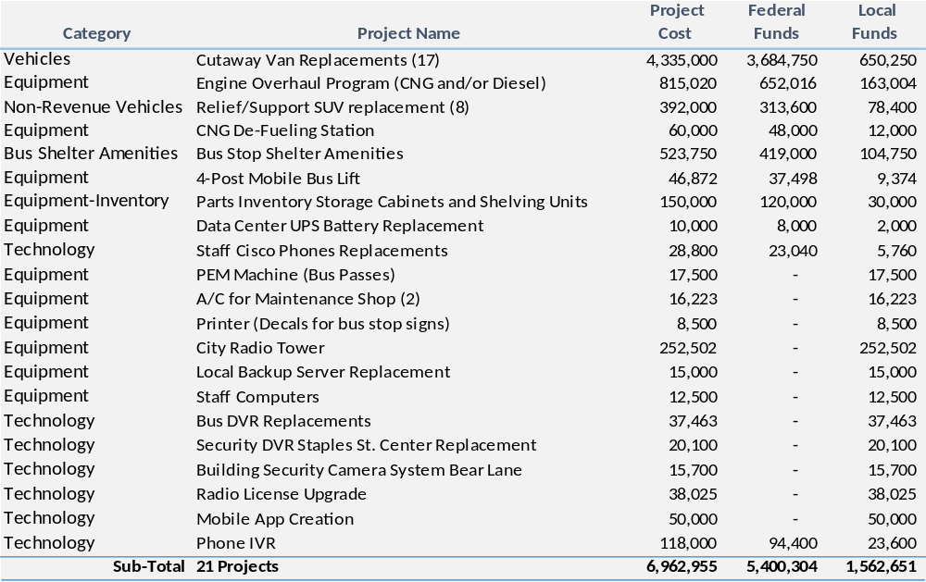
2020 Capital Budget

Slide 9
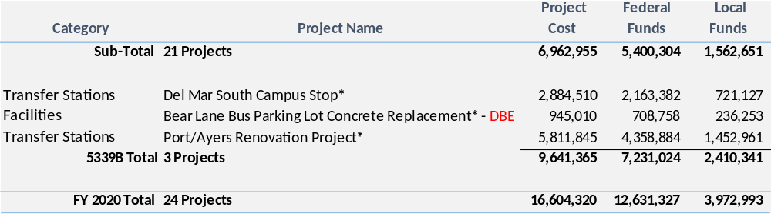
2020 Capital Budget
*Contingent on 5339B Grant Award

Slide 10
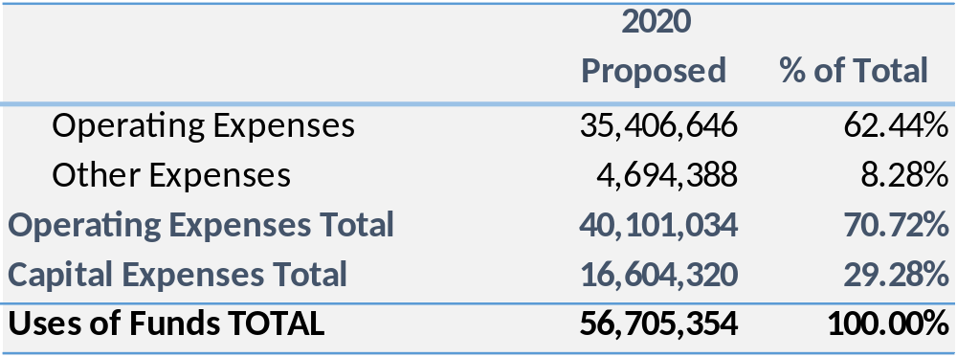
2020 Operating & Capital Budget

Slide 11
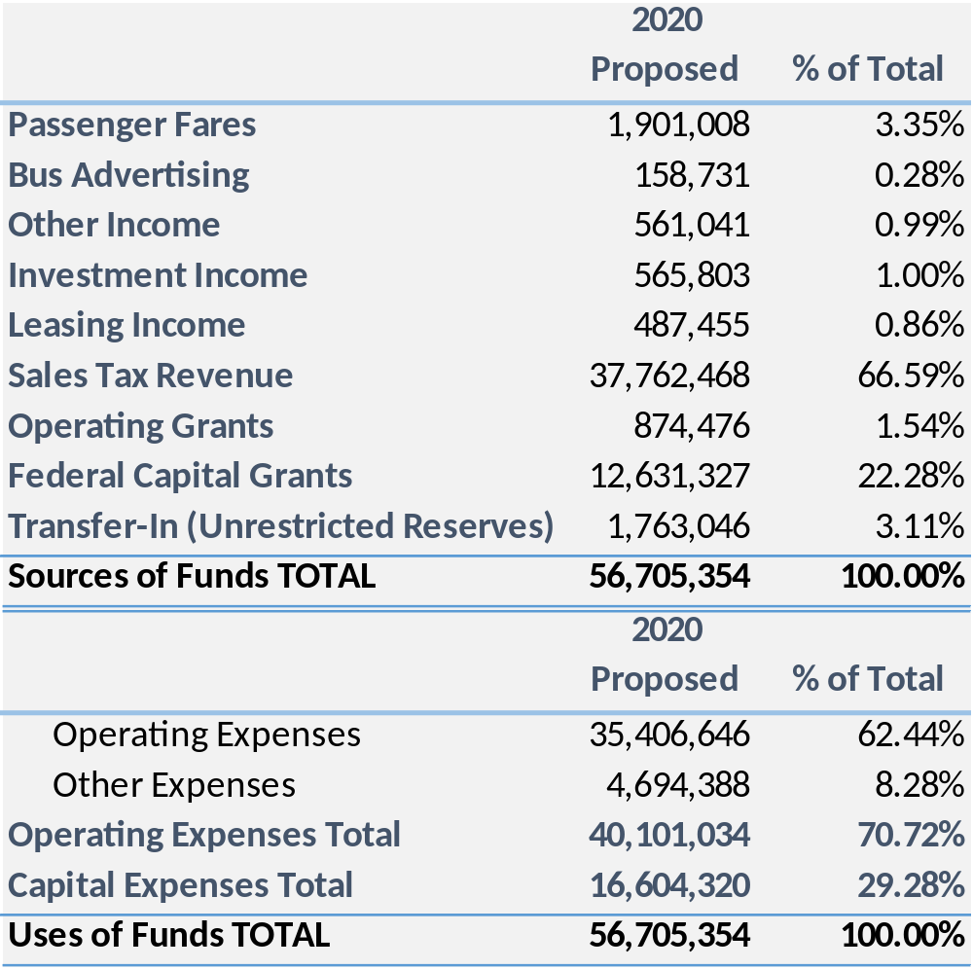
2020 Operating & Capital Budget
Notes:
5339B Awarded

Slide 12
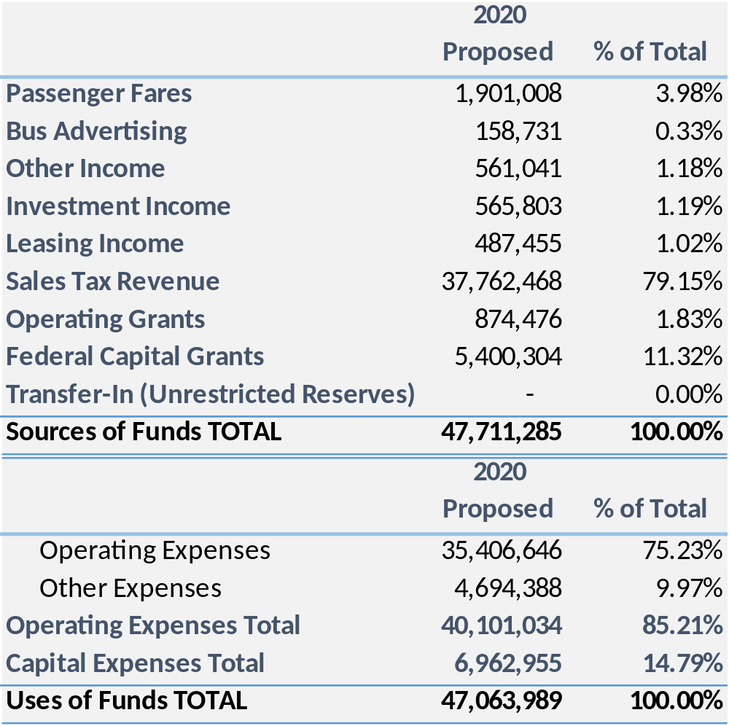
2020 Operating & Capital Budget
Notes:
5339B Not Awarded

Slide 13
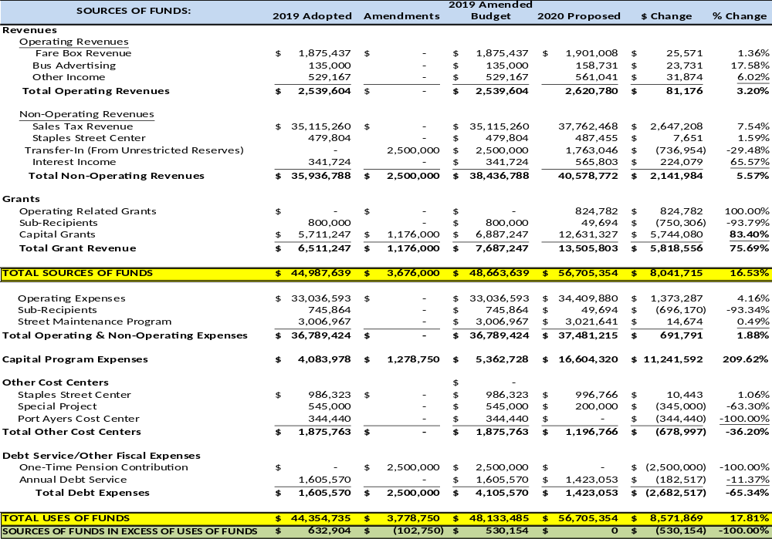
Notes:
2019 Adopted-2020 Proposed-$ Change-% Change
Through green line?
Monday Morning

Slide 14
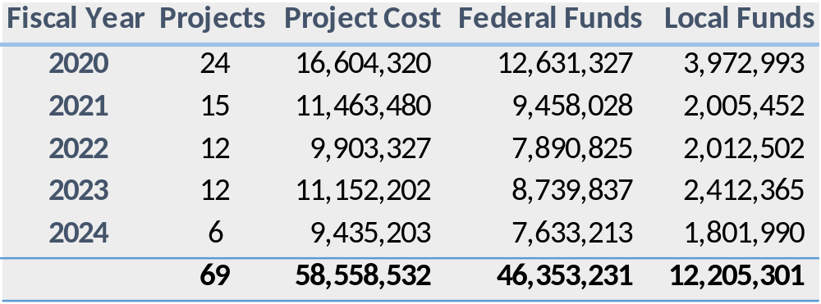
Five-Year Capital Improvement Plan
Preview

Slide 15
Five-Year Capital Improvement Plan
2020

Slide 16
Five-Year Capital Improvement Plan
2020
*Contingent on 5339B Grant Award

Slide 17
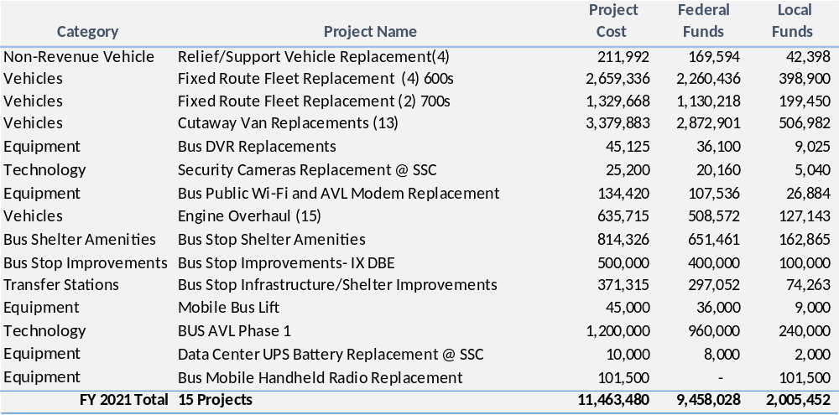
Five-Year Capital Improvement Plan
2021

Slide 18
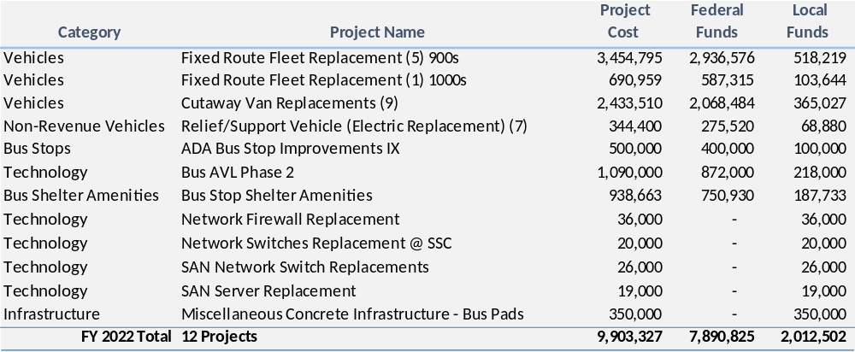
Five-Year Capital Improvement Plan
2022

Slide 19
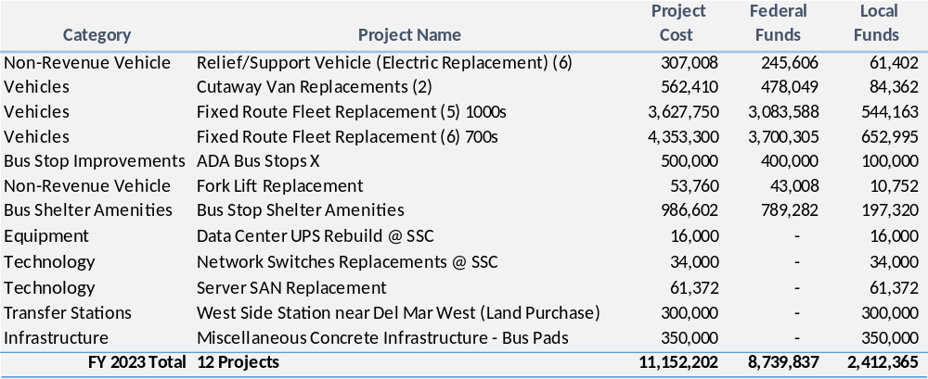
Five-Year Capital Improvement Plan
2023

Slide 20
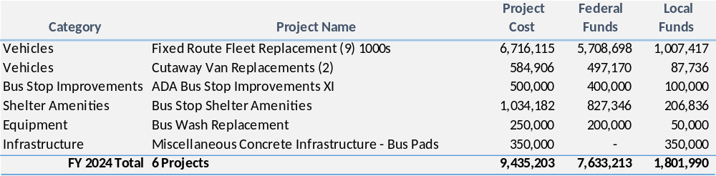
Five-Year Capital Improvement Plan
2024

Slide 21
Five-Year Capital Improvement Plan
2020-2024

Slide 22


Have Questions?
Thank You!

